Slide 1
RMA Local Media Preparation

Slide 2
Kathryn Kolaczek, CEO
Kathryn@alchemycommunications.ca
403-819-2547
www.Alchemycommunications.ca

Slide 3
Expectations
What we want you to get from today
Basic understanding of the media environment
More comfort with key messaging
Preparation for what a crisis may look like
Review of what not to do

Slide 4
Crisis Communications at Alchemy
Crisis Communications
National recall, baby food
Public Anger over Waste Water Treatment Project
Accusations of mismanagement of government funds from public to a large non profit
On site murder of client

Slide 5
Your First Interview
15-30-60-90 minutes
Nothingness has the potential to be filled with anything.
Jean Paul Sartre

Slide 6
Current State of Media

Slide 7
Heroes Vs. Villains Standard Crisis Narrative
How to be declared a villain in a crisis:
Say Nothing
Don’t take your time in making statements
Don’t correct mistruths
Get your senior team to hide
Heroes
Speak quickly, honestly and with integrity
Prepare for crises, take time to understand key messaging
Correct misinformation
Senior team stays front and centre

Slide 8
Media Don’t Break News Anymore
They repeat what has happened on social media.

Slide 9
Media Don’t Break News Anymore
Asiana Flight 214, July 6, 2003 Crash happens at 11:27am
First tweet from eye witness at 11:28am
Asiana first tweets at 12:39pm

Slide 10
Media Don’t Break News Anymore

Slide 11
Communications in the Time of COVID 19
Just when you think you have a plan, things change
Inputs are seemingly far fetched –but they are real
Nimble, flexible, and ‘unprecedented’ are becoming cliché
Don’t say unprecedented if you lived through the 80’s

Slide 12
Communications in the Time of COVID 19
Updates might need to be hourly, not daily
Ongoing, frequent media relations – be available
Paid advertising, traditional, and social may be necessary
Multilingual translations may be necessary
COVID 19 eats communications strategies for breakfast, lunch, and dinner. – Brad Ross

Slide 13
Props
Avoid (or preplan) props: We’ve all seen that television guest who holds up a piece of paper or newspaper article during a television appearance. It’s usually a bad idea. Few people know how to position an item properly for the camera, so it usually ends up distracting the audience.
Speak to producers prior to interview if you want to use a prop
https://www.youtube.com/watch?v=IR_QZpebjo8

Slide 14
Key Messages
A key message is the most important thing you want your audience to remember after the interview.
It will take time to create a key message that is clearly understood
no jargon
short enough to remember
interesting to the audience
says what you want the audience to do or remember

Slide 15
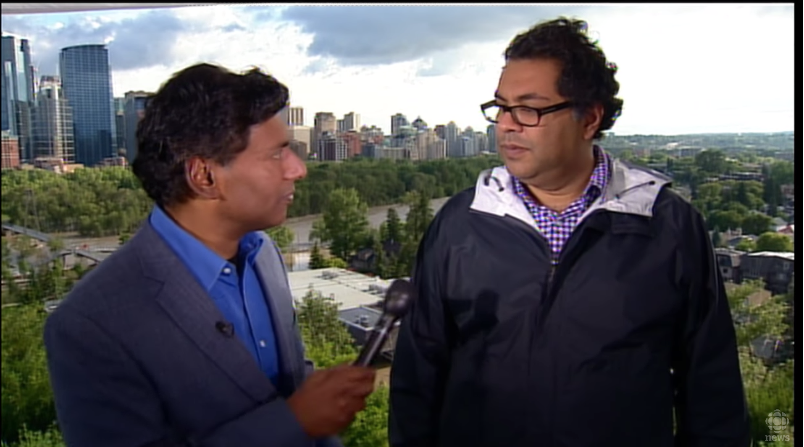
Control the Message
Regardless of what the interviewer asks you, you need to direct the response back to your key messages.

Slide 16
Apologies
Good
https://www.youtube.com/watch?v=zIsN5AkJ1AI
Bad
https://www.youtube.com/watch?v=u4jIBlTIkSk&ebc=ANyPxKro4GXnnuM_PyXIvFNrOhmpQP8tsuu72AsPQ-djFyf-DyFoAOQEOkQLmZfzYmIwoqgyGynvdmSly3KpQ3fqNbrWNvzSSA

Slide 17
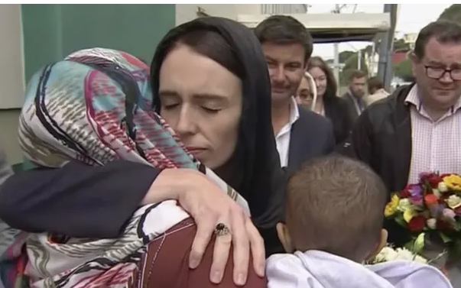
Apologies
“If in wearing the hijab, as I did, gave them a sense of security to continue to practice their faith, then I’m very pleased I did it,” she said. Jacinda Ardern, PM New Zealand

Slide 18
Crisis Communications Facebook
2016 Cambridge Analytica scandal, fake news epidemic, 42% users drop off
Facebook responds with slowly
Lack transparency
Questionable authenticity “The reality of running a company with over 10,000 people, is that you are not going to know everything that is going on.”

Slide 19
Facebook vs. Nike Authenticity
Facebook backs away from taking any responsibility
Nike, in the Colin Kaepernick situation, doubled down on the new spokesperson, engaging with the audience that admired him. https://youtu.be/-grjIUWKoBA

Slide 20
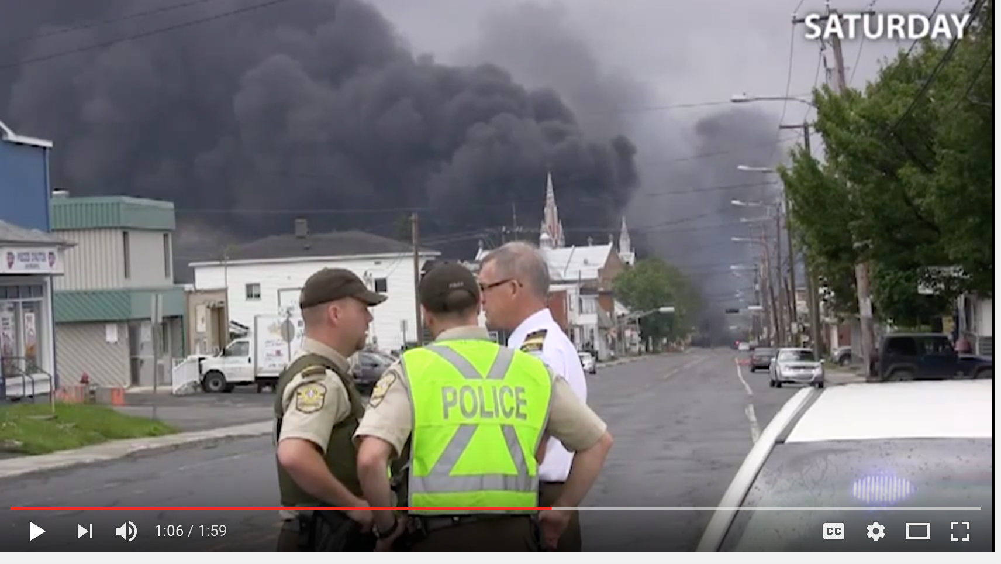
Crisis Communications in Transportation – Lac Megantic

Slide 21
Crisis Communications in Transportation – Lac Megantic
The first statement arrived 36 hours after the fire began.
- poorly translated, no social media
Rail World President doesn’t arrive for 4 days
Prior to visiting the accident site, the Rail World president commented: “I hope that I don’t get shot at. I won’t have a bulletproof vest on.”
Rail World President continues to blame the accident on the train being tampered with, doesn’t wait for investigation to conclude
A number of months after the incident, the Rail World CEO once again goes on to say that he was “also a victim” in this whole incident, while offering an apology
Local Responses
Due to the lack of reliable statements, much of the story rested squarely in the hands of local police and citizens, sharing a high level of social media about the incident. Research as indicated that there was no attempt by MMA or Rail World to get into immediate contact and coordination with these individuals over social media.
Local social media was put to strong use by the government organizations, keeping everyone updated from the area.

Slide 22
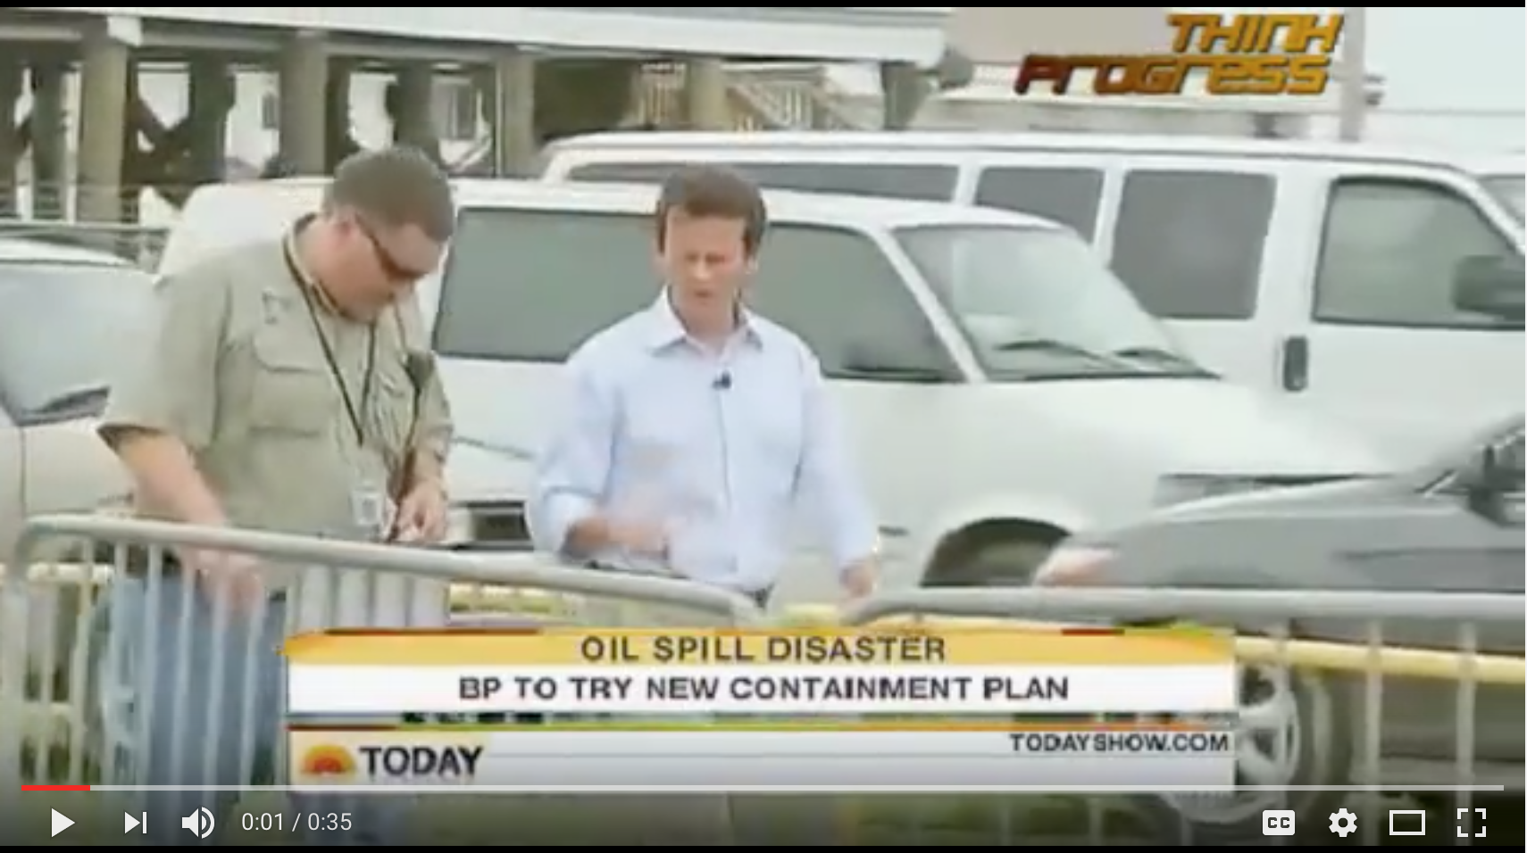
Crisis Communications BP Deep Water Horizon Crisis

Slide 23
General Rules in a Crisis Situation
Preparation
Have your messages well rehearsed on note cards
Memorize your messages, key words only
Only state facts, no guessing.
Introductions
Dealing with reporters is not a social gathering, state your name and title, then move to messages
How you Speak
The shorter your sentence, the better it will be. Think sound bite.
Be as clear and concise as possible
Use emotional language only in expressing your concern for people affected by the incident
Imagine your listener has the comprehension of a 12 year old, speak at that level
Start at the beginning, don’t assume everyone knows the context
Don’t lie or mislead – ever
Numbers can give you credibility, but use only a few and keep them rounded for simplicity

Slide 24
General Rules in a Crisis Situation
Messaging Structure
When writing statements for media, or answering questions, always follow this structure.
COMMUNITY, EMPLOYEES AND ENVIRONMENT FIRST
Context
Facts
Future

Slide 25
Classic Responses
Here are some classic responses to awkward questions:
That’s a very important question, but what is even more important is….
I’m very glad you asked me that….
Before I answer that question, I think I should say that…
That’s a very good question, and I will answer it in a minute, but before I do….
I think what you meant by that question is….
I don’t have the exact details, but what I can say is….

Slide 26
Classic Responses
Don’t be afraid to contradict or correct:
You might say that, but my experience is…
No, that is not true. The truth is…
I think you are wrong. In my view….
Please let me finish….
I don’t believe that is accurate. I don’t have that exact detail, but I can clarify that for you shortly. Would 20 minutes work for you?

Slide 27
Classic Responses - Conclusion
Ending of Press Conference or Journalist Conversation
Thank you, we will not be taking questions at this time.
I will take two more questions (choose journalists strategically) before we move back to the issue at hand.
I have 3 more minutes before I have to move on, what question can I answer for you?

Slide 28
Practice – the Errors
Correct town/ municipality name, personal name, website
Correct misinformation
Correct facts.

Slide 29
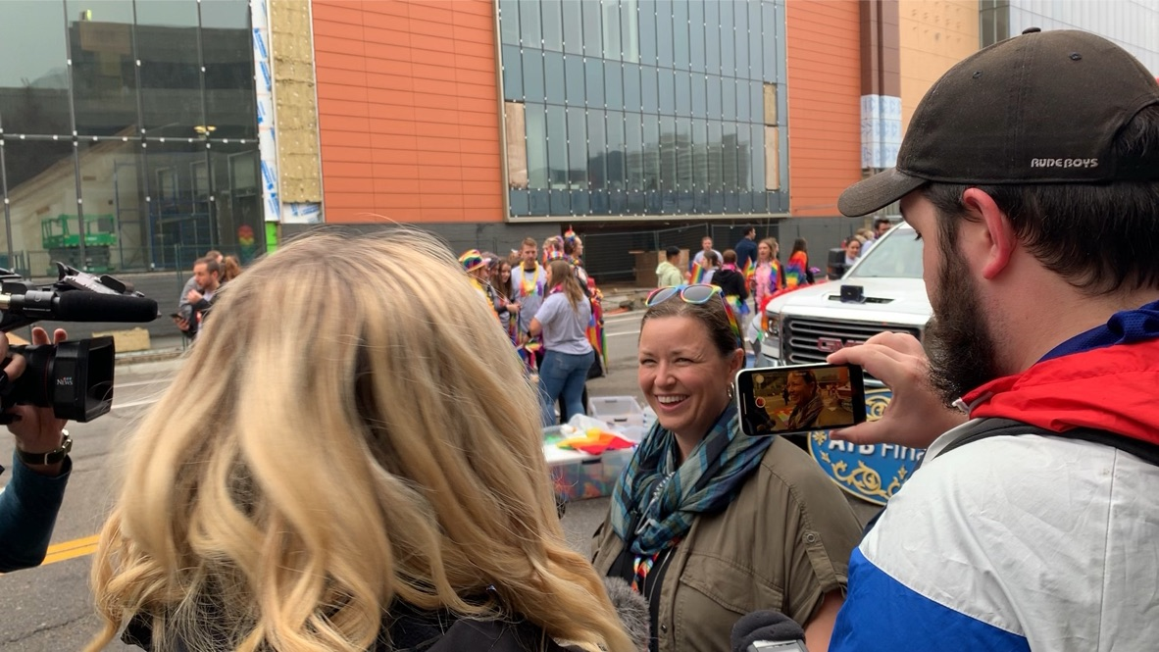
Practice – Antagonistic Journalist
What makes you a credible speaker?
What makes your organizations philosophy

Slide 30
Questions
Slides are available at kathryn@alchemycommunications.ca

